Slide 1
Institutional Accessibility for the Web
Gaeir Dietrich • HTCTU Director
www.htctu.net • www.toolsthatinspire.com
Notes:
www.htctu.net * Access to IT
1
1

Slide 2
High Tech Center Training Unit
Grant Program
Funded by the California Community Colleges Chancellor’s Office
Located at De Anza College in Cupertino, California
Train staff and faculty of the CCCs to use technology to assist students with disabilities
www.htctu.net

Slide 3
Context
What is “OCR”? And why should I care?

Slide 4
Publically Funded
Public money is not free
It comes with a responsibility to the “public”
It comes with strings attached: contractual obligations
It comes with oversight
And specifically for federal funds, it comes with a watchdog…the Office for Civil Rights

Slide 5
A Tale of Two Cities
San Francisco
Michigan

Slide 6
Unfunded Mandate?
Not really
Accessibility is part of our contractual obligation
AND historically, civil rights has never been specifically funded
We don’t get paid extra NOT to discriminate!

Slide 7
Emerging Technology and the Issue of Access
The Office for Civil Rights Is Not Pleased…

Slide 8
The “Kindle Letter”
www.htctu.net
8
June 29, 2010 Dear Colleague Letter (DCL)
Issued by the Office for Civil Rights (OCR)
Cosponsored by DOJ and Dept of Ed
Expresses concern over campuses adopting inaccessible technology

Slide 9
Concerns about Technology
www.htctu.net
9
Office for Civil Rights…
DCL June 29, 2010
“It is unacceptable for universities to use emerging technology without insisting that this technology be accessible to all students.”

Slide 10
Not Equal
Digital does not mean accessible!
Just because something is digital does not mean that it is accessible to all!

Slide 11
Potential Areas of Inequality
www.htctu.net
11
Learning management systems
Distance ed courses
Software in campus labs
Online books
Online documents
OER materials

Slide 12
Technology Complaints
Increasing number of technology complaints since the “Kindle Letter”
DOJ has added a new section on accessible technology to its ADA website
www.ada.gov/access-technology/index.html

Slide 13
Tech Complaints since the DCL…
Complaints have centered around
Lack of access
Inaccessible learning management systems
Inaccessible instructional materials
Inaccessible software used in instruction
Lack of availability of assistive technology
And especially, Web sites!

Slide 14
Recent OCR Resolutions
Louisiana Tech University
OCR complaint over MyOMLab
UM Missoula
OCR complaint over inaccessible learning management system (LMS) and inaccessible course materials
Web complaints

Slide 15
Louisiana Tech University
Must deploy accessible technology and course content in the University setting
The University shall provide ADA Training to instructors and administrators
“The University will only purchase, develop or use technology and instructional materials that do not exclude persons who are blind or who have other vision disabilities”

Slide 16
UM Missoula
Develop E&IT purchasing policy and procedures; train staff and faculty
Find an E&IT Coordinator
Make Web sites accessible (WCAG 2.0, level AA)
Ensure accessibility of LMS
Ensure accessible classroom E&IT (clickers, podiums, blogs, software, etc.)

Slide 17
Recent Web Access Cases
Bellingham School District
Davidson Academy of Nevada
Granite School District
Guam Department of Education
Juneau School District
Michigan Department of Ed
Montana School for the Deaf and Blind
Nevada Department of Education
Oregon Department of Education
Santa Fe Public Schools
Washington Office of Superintendent of Public Instruction
Washoe County School District

Slide 18
Consistent Requirements
Conduct accessibility audit of website
Make web pages accessible
WCAG 2.0 Level AA held as benchmark
Testing, accountability, quality assurance
Verify vendor’s accessibility claims
Content made accessible or removed from site
Include a process to report inaccessible content
Train all appropriate personnel on accessibility

Slide 19
In Addition
Michigan Department of Ed went further
Must include a notice of nondiscrimination on the website
Provide a method on the website to request an accommodation
Identify the individual responsible for ensuring web accessibility and provide contact information (name, title, email, phone)

Slide 20
OCR Lessons Learned
Make accessible
Buy accessible
Be accountable
Train everyone involved
Make it easy for people to report problems and receive support
Provide a notice showing your commitment to non-discrimination

Slide 21
AND
Commit the resources needed to make accessibility happen!
OCR expects us to take our contractual obligation seriously

Slide 22
Want to Read More?
U.S. Dept of Ed OCR Website
http://www2.ed.gov/about/offices/list/ocr/docs/investigations/index.html?exp=2#section504rev

Slide 23
One More Interesting Aspect…
www.htctu.net
23
Even though Section 508 did not directly apply to these schools, OCR held an expectation of purchasing accessible technology …
as a way of meeting obligations under Section 504 and the ADA

Slide 24
Strategy for Compliance
Purchase the most accessible products
Under Section 508
Accommodate those products as necessary
Under Section 504

Slide 25
508 + 504 Strategy
Section 508
Create accessible documents
Develop accessible software, apps
Build accessible websites
Purchase accessible hardware, software, and apps
Section 504
Accommodate as necessary

Slide 26
Section 504 vs. Section 508
One Act (Rehabilitation Act of 1973, as Amended) Two Laws
Notes:
www.htctu.net * Access to IT
26

Slide 27
Legal Requirements
Section 504
Federal law
Follows the money
Requires individuals with disabilities be provided with auxiliary aids and services (accommodations)
Equally effective communication
Section 508
California state law (since January 2003)
Requires accessible infrastructure

Slide 28
Rehabilitation Act of 1973
Section 504 is about accommodation.
Making it work for individuals
Disability service offices created to serve students’ needs.
Section 508 is about access.
Electronic & Information Tech (E&IT) infrastructure
Create accessible software, Web sites, videos, and documents.
Purchase accessible products.
Campuswide responsibility
Notes:
www.htctu.net * Access to IT
28
28
28

Slide 29
A Campus Analogy
Section 504
Deaf student requests that videos for her class be captioned
Section 508
New videos must be captioned before being shown in the classroom for the first time
Notes:
www.htctu.net * Access to IT
29
29
29

Slide 30
Campus Comparison
Section 504
Accommodation
Based on person’s request and preference
Campus disability office handles student requests / HR handles employee requests
Begins where 508 ends
Section 508
Access
No prior request needed—”open door”
All E&IT purchases are affected for entire organization—students, staff, and faculty
Ends where 504 begins
Notes:
www.htctu.net * Access to IT
30

Slide 31
Access vs. Accommodation

Slide 32
United We Stand
Access and accommodation work together
It’s a continuum
Not fully accessible? Accommodate.
But beware…
Some technology cannot be accommodated!
Notes:
www.htctu.net * Access to IT
32
32

Slide 33
Risk Management
The more long-lasting and broadly available, the more things need to be accessible
One-use materials or very limited availability, the more can rely on accommodation
Notes:
www.htctu.net * Access to IT
33

Slide 34
We’ve Got Your Back!
Accommodation is always the back-up plan for access!
Create and buy E&IT that is as accessible as possible
When access falls short…accommodate!
But remember: Accommodation is almost always more expensive and time consuming!

Slide 35
How will you accommodate?
Can still use materials that are not fully accessible, as long as you can accommodate individual needs in an equally effective manner
Make accommodation planning part of the design strategy and buying decisions!

Slide 36
What does accommodate mean?
Accommodations are intended to be individualized solutions
Can have a programmatic strategy BUT must be willing to adapt to individual need
Notes:
www.htctu.net * Access to IT
36

Slide 37
Accommodation Examples
Notetakers / permission to record
Extended time
Adapted materials
Occasionally able-bodied assistance
And sometimes course modifications

Slide 38
Course Modification?
Good to have clear learning outcomes
Work with DSPS to see how this student might meet the SLOs with accommodations
Please do not assume that because you cannot imagine how the student can meet the SLOs that the student truly cannot meet them!

Slide 39
Accommodation vs. Alteration
Not required to “fundamentally alter” your course
Makes SLOs so important!
Faculty member will be required to explain why the accommodation would be a fundamental alteration

Slide 40
OCR’s Expectations
Accommodation decisions will be made in consultation with the student
The student will be allowed to attempt to fulfill the work with the accommodations
Academic integrity will be maintained
If things don’t work, there is a grievance process

Slide 41
Deference
Deference is given to the faculty member in terms of academic requirements
However, we must attempt to accommodate the student
If accommodations are denied there must be a very good reason
And, inaccessible materials are automatically a compliance issue

Slide 42
And Remember
Do not require technology (software or hardware) that cannot be accommodated!
In other words, if it is impossible to make the technology equally as effective for all users, do not require it of all users.
Notes:
www.htctu.net * Access to IT
42

Slide 43
Following the Standards
If the Section 508 Standards are followed to ensure general access, there will be less need for accommodations!

Slide 44
Complying with the Section 508 Standards
Section 508 of the Rehabilitation Act of 1973, as amended in 1998

Slide 45
When Do Standards Apply?
Section 508 standards apply to the governmental entity
As purchaser of E&IT
As creator of E&IT
Standards are not enforceable on the vendors!
Compliance is up to the organization
And is enforced by user complaint

Slide 46
Remember the Acronym
Section 508 applies to Electronic & Information Technology (E&IT) that is “DUMPed”
D: Developed
U: Used
M: Maintained
P: Procured

Slide 47
Section 508 in Action
Make Web sites accessible
Follow the 508 or WCAG Standards
Make software created by organization accessible
Make videos & multi-media accessible
Purchase accessible Electronic & Information Technology (E&IT)
ICT: Information & Communication Tech
Notes:
www.htctu.net * Access to IT
47

Slide 48
Complying with Section 508
Two types of E&IT standards
1. Standards for purchasing
Using checklist under Subpart B
OR using functional standards under Subpart C
2. Standards for creating
Web pages
Web applications
Software
Notes:
www.htctu.net * Access to IT
48

Slide 49
The First Part of the Standards: Purchasing
At its heart, Section 508 is procurement law.

Slide 50
California State Law
SB 105
Applied standards of Section 508 to California
Passed September 29, 2002
Effective January 1, 2003
Became part of Govt. Code 11135
CCCs accepted this as applying to them

Slide 51
Cal. Gov. Code §11135(d)(2)
"In order to improve accessibility of existing technology, and therefore increase the successful employment of individuals with disabilities, particularly blind and visually impaired and deaf and hard-of-hearing persons, state governmental entities, in developing, procuring, maintaining, or using electronic or information technology, either indirectly or through the use of state funds by other entities, shall comply with the accessibility requirements of Section 508 of the Rehabilitation Act of 1973, as amended (29 U.S.C. Sec. 794d), and regulations implementing that act as set forth in Part 1194 of Title 36 of the Federal Code of Regulations."

Slide 52
More CA State Law
SB 302
For the CSUs
“Yes, we meant you, too.”
Passed September 2, 2003
Effective January 1, 2004
Became part of Govt. Code 11135
Does not apply to UCs.
Many conforming voluntarily

Slide 53
State vs. Federal Law
California state law actually puts some responsibility for conforming to the standards on the vendor.
Notes:
53

Slide 54
§11135(d)(3) states:
"Any entity that contracts with a state or local entity subject to this section for the provision of electronic or information technology or for the provision of related services shall agree to respond to, and resolve any complaint regarding accessibility of its products or services that is brought to the attention of the entity."

Slide 55
Just to be clear…
Section 508 standards apply because of California state law
Section 504 applies when colleges accept federal funding
Section 504 follows the money; Section 508 does not

Slide 56
Purchasing Electronic and Information Technology
E&IT

Slide 57
Where Do We Begin
Only electronic and information technology (E&IT) is covered by Section 508.
But covered for staff and students
First determine if the proposed purchase is E&IT.

Slide 58
Buying Accessible
Section 508 purchasing
Buy the most accessible product that you can that meets your business and academic needs
Compare and contrast models/software etc. and purchase the most accessible one
When it’s not accessible, plan for accommodation

Slide 59
Purchasing Summary
Determine functional requirements
Determine what products are available
Pick the most accessible product
Plan to accommodate
And remember: do not require what cannot be accommodated
Notes:
www.htctu.net * Access to IT
59
59

Slide 60
The Second Part of the Standards: Creation
In the beginning was the Web…

Slide 61
End-to-End Access
It’s like a chain—all links must be strong!
All the parts must be accessible
The hardware
The software (LMS, learning software, app)
Everything loaded into the LMS
If any of these is inaccessible, the user will be locked out of the online course.

Slide 62
Content vs. Container
Academic freedom is about the content.
Section 508 is about the container.
Conforming to Section 508 simply allows equal access to the content.
www.htctu.net
62
Notes:
62
62
www.htctu.net * Access to IT
62
62

Slide 63
Instructional Materials Online
Build in accessibility before putting the material online!
All online instructional materials need to be accessible
PDFs
PowerPoint presentations
Podcasts
Videos
Software
www.htctu.net
63
Notes:
www.htctu.net * Access to IT
63
63

Slide 64
What Needs to be Accessible?
Online documents
Must be text (not scans) and have structure (headings, etc.)
Graphics
Add “alt text”—brief description
Videos and multimedia
Captioned
Back-up plan for audio description

Slide 65
What about Software?
Learning software/apps
Either has built-in accessibility or works with assistive technology
Learning objects
Either accessible from the vendor or can be made accessible

Slide 66
And if it’s not accessible?!?
Work with DSPS to determine if an equally effective alternative exists
If an equally effective alternative does not exist, you cannot require the material / software / learning object, etc.

Slide 67
Accessible?
What does it mean to be accessible?
Web Content Accessibility Guidelines (WCAG) 2.0 from the W3C (World Wide Web Consortium)
WCAG 2.0 Level AA
http://www.w3.org/TR/WCAG20/

Slide 68
How Do We Do It?
Think Accessible!

Slide 69
Think Access First!
Design to the standards
Remember POUR
Perceivable
Operable
Usable
Robust

Slide 70
Nuts and Bolts of Access
Graphics
Alternate text description
Documents
Word
PowerPoint
PDF
Videos
Learning objects/learning software

Slide 71
Great Resources
WebAIM
www.webaim.org
WAI
Web Accessibility Initiative from the W3C
http://www.w3.org/WAI/

Slide 72
Accessible Documents

Slide 73
What Does Accessible Mean?
Documents/text must be…
Readable with screen readers or other text-to-speech (TTS) programs
All elements must be understandable
All elements must be perceivable
Graphics described
Fonts must be readable
When color is used, make sure it is not the only method of conveying meaning

Slide 74
Accessible Documents
For maximum accessibility include both the PDF and the Word document online
PDF and RTF

Slide 75
Videos

Slide 76
Accessible Multimedia
Videos must be captioned
Post captioned video and transcript
Action in videos needs to be verbalized
Verbalize all steps for instructor-created material
Back-up plan for audio description of commercial material
Check with DSPS

Slide 77
Section 508 on Videos
www.htctu.net
77
(c) All training and informational video and multimedia productions which support the agency's mission, regardless of format, that contain speech or other audio information necessary for the comprehension of the content, shall be open or closed captioned.
Notes:
www.htctu.net * Access to IT
77
77

Slide 78
Interpretation
www.htctu.net
78
Videos must be captioned before they are shown in the classroom for the first time
Uncaptioned videos may be purchased and someone (ordering department?) pays to have them captioned
Under 508, captioning required whether or not deaf students will be in the class
Notes:
www.htctu.net * Access to IT
78
78

Slide 79
How do we do this?
www.htctu.net
79
Purchase captioned videos when possible
Include cost of captioning in budget when purchasing uncaptioned videos
Purchasing department usually pays
Check with DSPS for vendors
Notes:
www.htctu.net * Access to IT
79
79

Slide 80
“Raw Footage” Videos
If video is single-use, one time ONLY, and not archived, accommodate as necessary, rather than captioning
Please note: One time ONLY does not mean one time this semester! It means one time only EVER!
This caveat allows for the “teachable moment”
Decide to use it again? Get it captioned ASAP!

Slide 81
You Tube
www.htctu.net
81
Yes, can be captioned
Your own channel?
Captions required by law on ANY video created by campus
Not your channel? Contact YouTube copyright owner about adding captions
Can’t reach the owner? Stream captions outside the YouTube interface

Slide 82
When to Caption Other’s Videos
www.htctu.net
82
If it is a single-use for a limited audience, accommodate as necessary
If you plan to use multiple times or with everyone on campus, caption
If it is archived, then caption
If you need to use it right now but want to archive…caption as soon as you can
Notes:
www.htctu.net * Access to IT
82

Slide 83
YouTube “Auto Captions”
Just say: NOT GOOD ENOUGH!
Auto captions are not accurate
Expectation is 99%-100% accurate; YouTube? They claim about 80%
Auto captions do not include punctuation
Lets eat grandma vs. Let's eat, Grandma!
I’m sorry I love you vs. I’m sorry. I love you.

Slide 84
You Tube “Auto Captions”
Are not really captions…
No sound information
Speakers not identified
Not sufficiently accurate
No, they are not, “Good enough”
Can be a starting point and edited to 100% accuracy if you have access to the channel

Slide 85
Captions
Include all spoken dialogue, word-for-word, 100% accurate
Also information on how dialogue is spoken, e.g., “shouting”
Include proper punctuation
Include speaker identification
Include information about sounds
Dogs barking, doors slamming, music, etc.

Slide 86
Ouch!
Punctuation matters!
Not sure? See Eats, Shoots & Leaves by Lynne Truss

Slide 87
Summary
You Tube “auto captions” are not really “captions”
It is really auto transcription using speech to text technology.
Accuracy not high enough
Offline captioning requires 100% accuracy
No “sound information”
Captions include descriptions of relevant sounds

Slide 88
Instructor-created AV Materials
Videos / podcasts
Work from a script so that captioning is easy
Not a “script person”? Learn to use speech-to-text software (like Dragon NaturallySpeaking)
Verbalize your process so that you do not need to audio describe
Say everything you do

Slide 89
AV Workflow
Develop outline / storyboard
Write out script
Or use Dragon NaturallySpeaking
As you develop graphics describe them
Alternative “description”

Slide 90
A Note on Dragon
Dragon works really well with one person sitting at a desk
Learn to use the program
http://www.htctu.net/trainings/manuals/ contributions/maincontribute.htm#dragon
Train special vocabulary in advance for best recognition

Slide 91
Once Dragon Is Trained
With a good “profile” can run your recordings through Dragon to generate a transcript
Light editing may be required

Slide 92
Synching
Once you have a transcript, synchronizing with the speech is often quick and easy
Amara / Subtitle Horse / Dot Sub
Do-it-yourself captioning
Aeneas—automatic and free
http://www.readbeyond.it/aeneas/
Automatic Sync Technologies (AST)
Inexpensive to just synch

Slide 93
DECT Grant
http://www.canyons.edu/Offices/DistanceLearning/Captioning/Pages/default.aspx
Live and asynchronous captioning and transcription
Captioning is FREE
Get preapproval for number of minutes
AND DECT grant does require copyright permission

Slide 94
Caption Guidance
Best guidance from the Described and Captioned Media Program (DCMP)
DCMP Captioning Key
Specifics on how to caption
DCMP also has a resource for audio description

Slide 95
Audio Description
www.htctu.net
95
Law does require it
Can be technically very challenging
However, only needed in order to make content clear
Can potentially be handled by other means

Slide 96
Not Accessible?
What are my options…

Slide 97
And if it’s not accessible?!?
Work with DSPS to determine if an equally effective alternative exists
If an equally effective alternative does not exist, you cannot require the material / software / learning object, etc.

Slide 98
Just to Be Clear
If learning materials cannot be made accessible for ALL students, you cannot require those materials of all students
Want to use it anyway?
Make it an option—one of many options
Ensure there are other roads to success!

Slide 99
Strategies for Working with Your Campus

Slide 100
Decide Where to Start
Remember risk analysis
Start with areas of greatest exposure
Look for low-hanging fruit
When you rewrite, recreate, revise, add accessibility to the LIST

Slide 101
Find Places to Draw Lines
Find areas to say “from now on…” and then rely on accommodation to fill in behind you—talk to DSPS
Videos
From now on…all videos either purchased captioned or captioned before use
Caption legacy materials as an accommodation

Slide 102
Make a Plan
Having a plan with a schedule will go a long way to limiting liability
And remember…accommodation is your back-up plan!
Work with DSPS to see if an equally effective alternative is possible
Don’t require what cannot be accommodated

Slide 103
Getting Real
Risk management and common sense
Create a culture of access
The greater the usage—the more need for access
The more restricted the access—the more reliance on accommodation
Make accommodation part of the access plan!

Slide 104
Getting Buy-in
Make sure that faculty understand that accessibility is not the enemy of academic freedom
Make sure that all document creators understand that accessible design will save time and effort in the long run
Make sure that all online designers realize that accessibility is part of good design

Slide 105
You Have the Power
Be proactive with vendors
Ask if textbook publisher will provide e-text for students with print disabilities
Ask if videos are captioned
Ask if software is accessible for students with disabilities
When campuses across the country put their collective foot (feet?) down, vendors will respond!

Slide 106
Where is the easy button?
Get book orders in on time
Learn to use MS Word
Talk to vendors
There’s a lot of power in asking!
Ask about access before you buy!
Learn to use the PDF Wizard

Slide 107
Easy Web Button
Make sure your footer has an “accessibility link”
To report accessibility issues
To request accommodations for materials on your website
To contact “help desk” about accessibility questions
Make sure report form is accessible!!
Have nondiscrimination statement

Slide 108
Web Checker Tools
Free tool licensed for CCCs
Compliance Sheriff
Contact Sean Keegan
CCC Accessibility Center
http://cccaccessibility.org/
accessibility-info@cccnext.net

Slide 109
Beyond Access
You are required to have a statement of nondiscrimination on your website
We can go beyond access to inclusion
Example of welcome and accessibility statement for an online course from Sheryl Burgstahler, DO-IT Director
http://www.washington.edu/doit/

Slide 110
Sheryl Burgstahler, Ph.D.
This course is designed to be welcoming to, accessible to, and usable by everyone, including students who are English-language learners, have a variety of learning styles, have disabilities, or are new to online learning. Be sure to let me know immediately if you encounter a required element or resource in the course that is not accessible to you. Also, let me know of changes I can make to the course so that it is more welcoming to, accessible to, or usable by students who take this course in the future.

Slide 111
Teach to All Learners
Encourage universal design
http://www.cast.org/udl/
http://enact.sonoma.edu/
http://www.udlcenter.org/
https://assett.colorado.edu/
Designing for access with designing for all learners

Slide 112
Resources
Others can help!

Slide 113
Learning from Others
W3C – WCAG 2.0
WCAG 2.0: http://www.w3.org/TR/WCAG20/
Web Accessibility Initiative
WAI: http://www.w3.org/WAI/
DO-IT (University of Washington)
http://www.washington.edu/doit/
WebAIM
http://webaim.org/

Slide 114
Digital Media
DCMP Captioning Key
http://www.dcmp.org/captioningkey/
NCAM – STEM
http://ncam.wgbh.org/experience_learn/educational_media/stemdx/guidelines
WGBH – Web Media
http://ncam.wgbh.org/invent_build/web_multimedia/accessible-digital-media-guide/guideline-h-multimedia

Slide 115
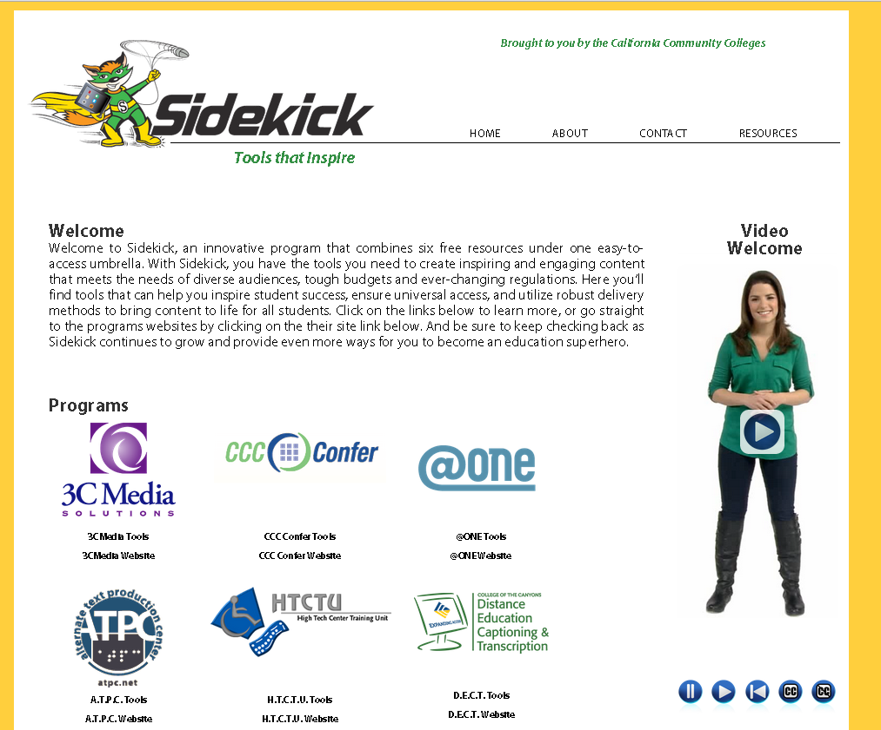
One Site for Free Assistance
@ONE: Course on accessibility for online ed
Sidekick
www.toolsthatinspire.com

Slide 116
Thank you!
Gaeir (rhymes with “fire”) Dietrich
gdietrich@htctu.net
408-996-6047
www.htctu.net
www.toolsthatinspire.com

